Slide 1
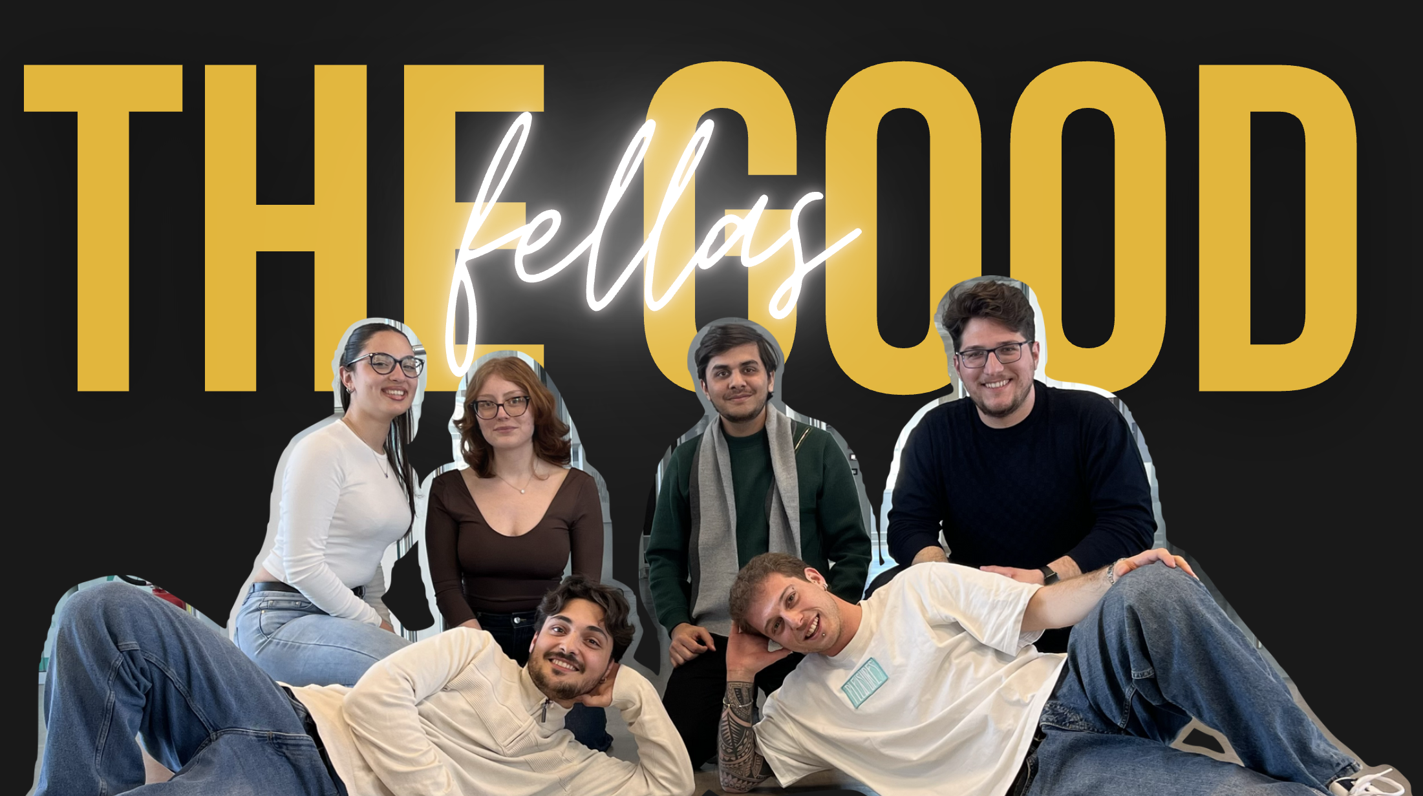
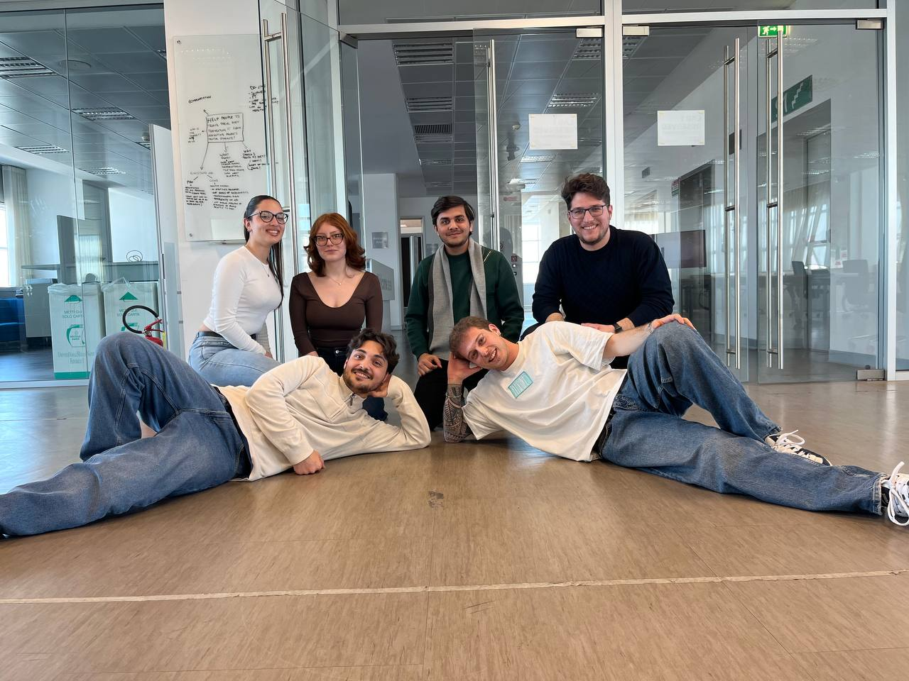
Notes:
ALESSANDRO STILL PRESENTING
Notes:
- Begin by introducing yourself and each team member briefly (name, role, and a fun fact, if appropriate).
- Include a team photo or Memojis to make it more engaging and personal.
- You can also Highlight each team member’s contribution to the project, showing appreciation for the collaborative effort.
- Maintain eye contact with the audience to create a connection.
- Keep the introduction concise to maintain the audience’s interest and transition smoothly into the presentation.

Slide 2




THIS IS THE STORY OF ALI!
Notes:
Qui ancora Alessandro
Notes:
Transition smoothly from the team introduction to the main topic.
Start by presenting the big idea in a clear and concise statement.
Explain why this idea matters and its potential impact.

Slide 3

Cooking alone
MAY WE PRESENT YOU:
􁐅
COOKING
PANDA

Slide 4
Don’t use traditional cooking books
91%
Based on 5690 people aged 18-34
Source: The Times
Notes:
Qui AleMadda
Notes:
Outline the research process you followed to address the challenge.
**IMPORTANT**: Highlight key methods used (e.g., surveys, interviews, competitive analysis).
Include visuals like charts, graphs, or images to illustrate the research outcomes.

Slide 5
Buy pre-cooked food
62%
Based on 9000 people aged 16-26
Source: Rapporto Eurispes
Notes:
Qui AleMadda
Notes:
Outline the research process you followed to address the challenge.
**IMPORTANT**: Highlight key methods used (e.g., surveys, interviews, competitive analysis).
Include visuals like charts, graphs, or images to illustrate the research outcomes.

Slide 6
Eat out once or twice a week
66%
Based on 9000 people aged 16-26
Source: Ipsos
Notes:
Qui AleMadda
Notes:
Outline the research process you followed to address the challenge.
**IMPORTANT**: Highlight key methods used (e.g., surveys, interviews, competitive analysis).
Include visuals like charts, graphs, or images to illustrate the research outcomes.

Slide 7
What do we want to do?
Make the experience:
engaging
interactive

Slide 8
FUN!

Slide 9
How?

Slide 10
Gamification
􀛸
MAY WE PRESENT YOU:
COOKING
PANDA
Is the future of Learning

Slide 11

COOKING
PANDA
Notes:
Adriana qui
Notes:
LIVE DEMO
- Introduce the live demo with excitement to engage the audience:
"Now, let’s see [App Name] in action!”.
Emphasize the app’s ease of use and its ability to solve the user’s problem effectively.
Prepare a backup plan (e.g., video recording) in case of technical issues.
Use a bezel to incorporate the live demo of the app. Download the bezels here: https://devimages-cdn.apple.com/design/resources/download/Bezel-iPhone-16.dmg

Slide 12
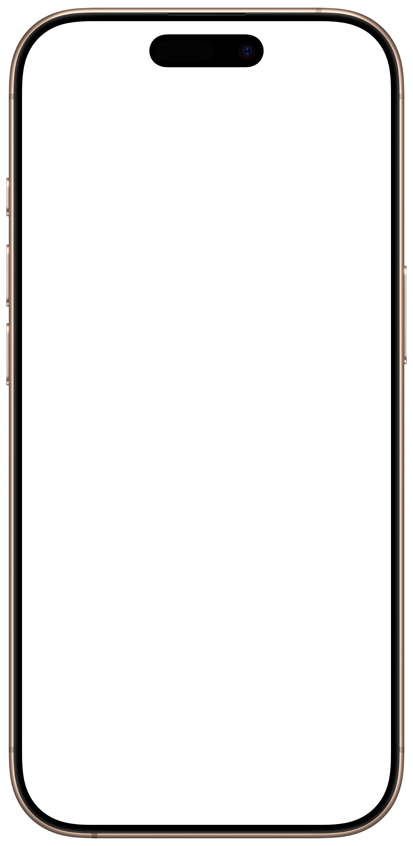

Hello!
Notes:
Adriana qui
Notes:
LIVE DEMO
- Introduce the live demo with excitement to engage the audience:
"Now, let’s see [App Name] in action!”.
Emphasize the app’s ease of use and its ability to solve the user’s problem effectively.
Prepare a backup plan (e.g., video recording) in case of technical issues.
Use a bezel to incorporate the live demo of the app. Download the bezels here: https://devimages-cdn.apple.com/design/resources/download/Bezel-iPhone-16.dmg

Slide 13




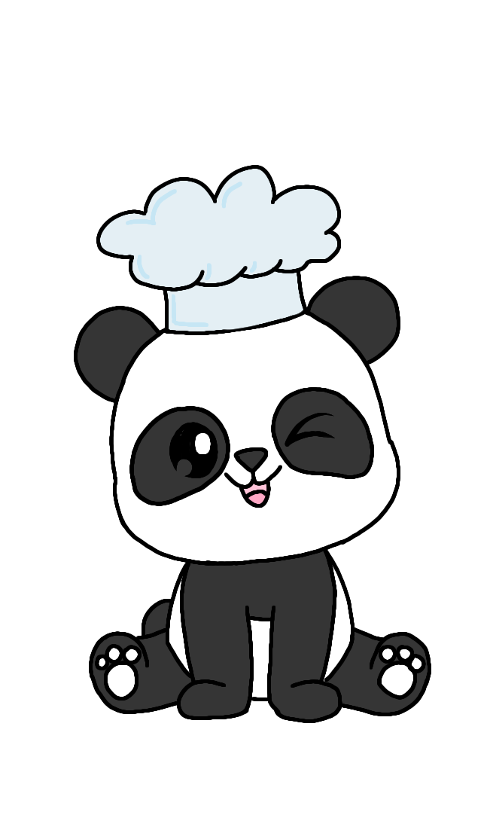
MAIN TOOLS
MAY WE PRESENT YOU:
COOKING
PANDA
Filters.
Identity.
Social.
􀜓
􀉪
􀝋
TheMealDB
AirTable
ibisPaint
Notes:
Inizia Fabio
The technologies that we used to develop this app, apart from Xcode and SwiftUI, are these three.
The first one, TheMealDB is a huge online database of recipes that is usable thanks to a free API. It contains recipes categorised in different categories, so that we can even choose what kind of food we want to cook. The database is constantly updated, in such a way that the list of recipes in our app can be updated as well.
The second one, AirTable, is an online service that we used to store the data taken from the database and to insert it into the app. Thanks to it, we could also add custom recipes, other than the ones present on our database.
Lastly, we have ibisPaint, the app that our team member Adriana used to draw all the pandas by hand. If we managed to have our mascotte “Pandavacciuolo” it’s all thanks to her and this app.
Notes:
- Introduce the technologies with a statement like: "Here are the tools and technologies we used to bring [App Name] to life."
- List the key technologies, frameworks, and platforms used (e.g., SwiftUI, SwiftData, Airtable… etc..).
- Highlight how each technology contributed to solving specific challenges or enhancing the app’s functionality.

Slide 14

Filters.
Identity.
Social.
􀜓
􀉪
􀝋
Notes:
For the future implementation, we thought of three main components
Filters for the recipes, using the categories present on AirTable, so that the app can satisfy users with particular tastes or needs
Identity of our users, we can augment the feel of customisation of our users by inserting avatars or some form of rewards for the ones that choose to specialise in one type of
Notes:
- Introduce this slide with a forward-looking statement like: "Looking ahead, here are the steps we plan to take to enhance [App Name]."
List planned features or improvements based on future goals (e.g., new functionalities, scalability, design enhancements).
Highlight any opportunities for growth, such as expanding the user base or integrating with additional technologies.
Use sentences like: "In the future, we plan to integrate [technology] to expand functionality.” - “We aim to add [feature] to further enhance the user experience.” etc…

Slide 15
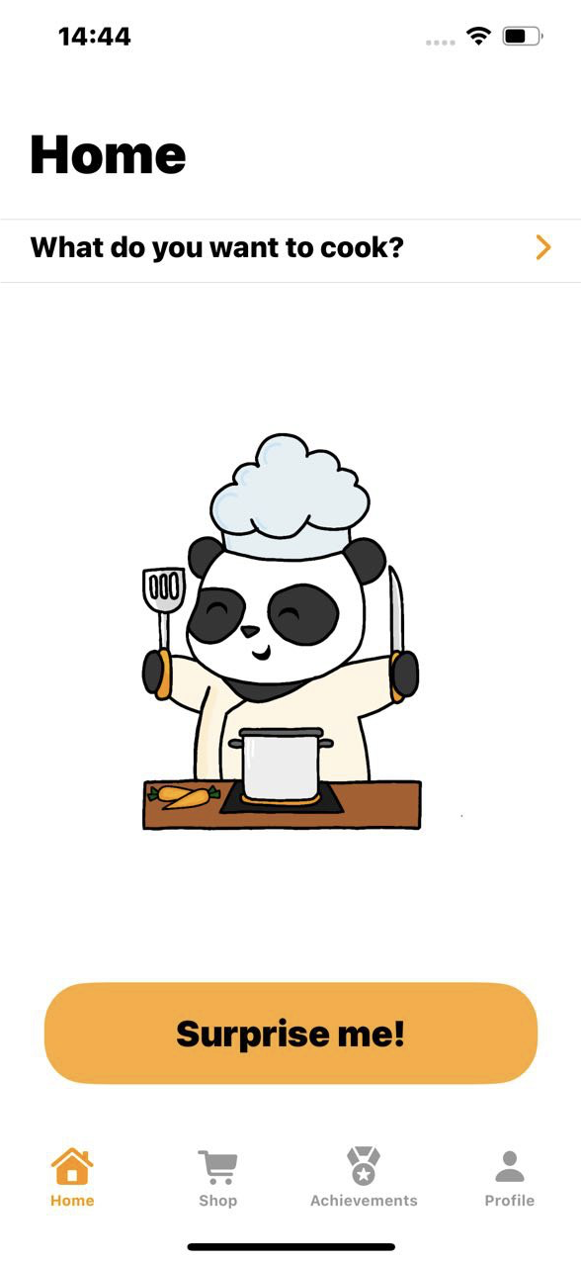
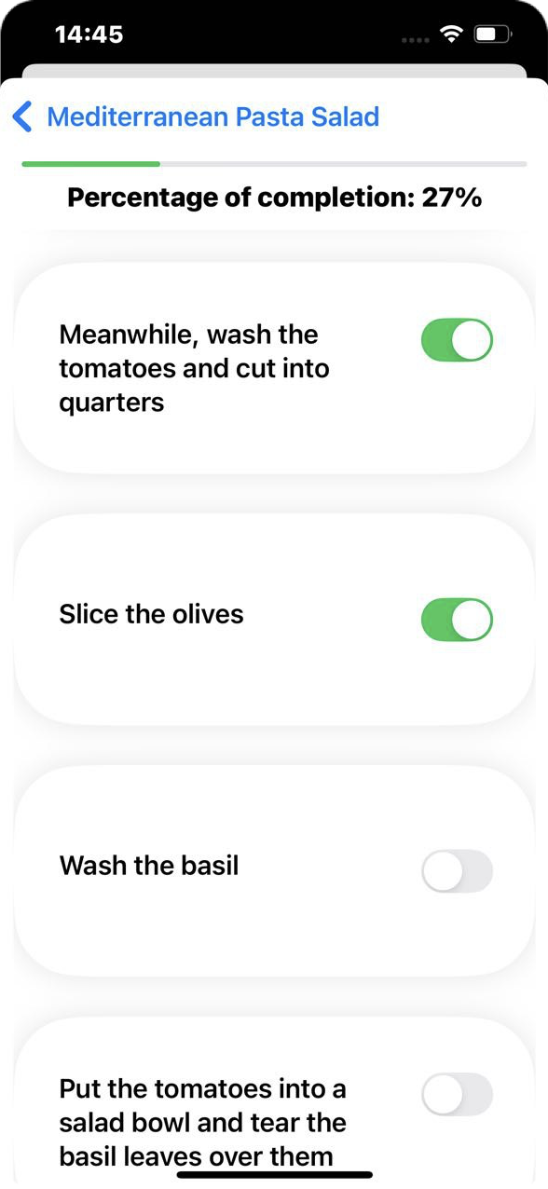



The good fellas
Adriana Palmese, Ciro Cafora, Alessandro Maddaloni, Ali Raza, Angelica Sannino, Fabio Fontana
Cooking Panda
Cooking, Education
Filters.
Identity.
Social.
􀜓
􀉪
An app that teaches people how to
cook while having fun, helping them
sticking to it
􀝋
Notes:
Notes:
- Summarize the key points from the presentation.
Reinforce the problem, solution, and how the app addresses the needs of the users.
Highlight the app's core features or the most impactful takeaways.
Here are a few examples of how you can end your presentation with a strong closing:
“Thank you all for your attention! If you have any questions or feedback, we’d love to hear from you!”
"We’re proud of what we’ve created with [App Name], and we believe it will make a positive impact on the way [target] engage with [topic]. Thank you for your attention!”
"We hope that [App Name] has inspired you as much as it has inspired us. We believe in its potential, and we’re excited for the future. If you have any questions or feedback, we’d love to hear from you!”

